Slide 1
The CSE Machine
Programming Languages
Lecture 7
Adeesha Wijayasiri

Slide 2
Evaluation of RPAL Programs
Need an algorithm to complete the operational semantic specification of RPAL

Slide 3
Introducing the CSE Machine
C - Control
a sequence of operations
S - Stack
operands
E - Environment
Initially, PE (Primitive Environment)
Updated as evaluation proceeds
PE: a mapping from names to objects and operations.

Slide 4
CSE Machine programs: control structures
Flatten the RPAL program's ST into a "control structure“
Done using a simple pre-order tree traversal.

Slide 5
Example
Evaluate -2 ** (a-b), in an environment in which (somehow) a=6 and b=1.
Flattened control structure: γ neg γ γ ** 2 γ γ - a b.
Place this control structure on the Control of the CSE Machine.

Slide 7
CSE Machine Operation (informally)
Remove right-most item from control.
If a name, look it up in the CE (current environment), push onto the stack.
If γ, then
rator = pop(stack)
rand = pop(stack)
push(apply(rator,rand), stack)
Stop if control is empty: value on the stack is the result.

Slide 8
Notes
Minus: function that subtracts its second argument from its first one.
Minus6: a function that subtracts its argument from 6.
Exp, likewise: the exponentiation function.
Exp2: function that raises 2 to the power of its argument.

Slide 9
Notes (cont’d)
Notice difference between "neg" (a name), and "Neg" (the actual operator).
Control contains gammas (and lambdas) and names. Stack contains "real" values.

Slide 10
Generating Control Structures
Begin with CS (control structure) δ₀:
Perform a pre-order traversal of the standardized tree.
For each node:
If a name, add it to the current CS.
If a γ, add it to the current CS.
If a λ, add <λ k x> to the current CS.
k: new index; x: λ's left child.
Generate control structure δ_{k}: traverse the λ's right child.

Slide 11
Generating Control Structures
We use a single symbol to represent a λ -expression, both on the control, and on the stack. The symbol is <i λ k x>.
i: environment,
k: CS of the function's body,
x: the function's bound variable.
The λ -expression becomes a λ -closure when its environment is determined, when it is placed on the stack.

Slide 12
Examples
Three examples of generating control structures.

Slide 16
Operation of the CSE Machine
Five rules
Process driven by TOP symbol on the control.
Need environment markers, on the Control and Stack.
Every environment is linked to a previously created (but not necessarily currently active) environment.
Thus, environment structure is a tree.

Slide 18
Examples of CSE Machine Operation
Let’s run through the CSE machine, for our 3 examples.

Slide 19


Slide 20
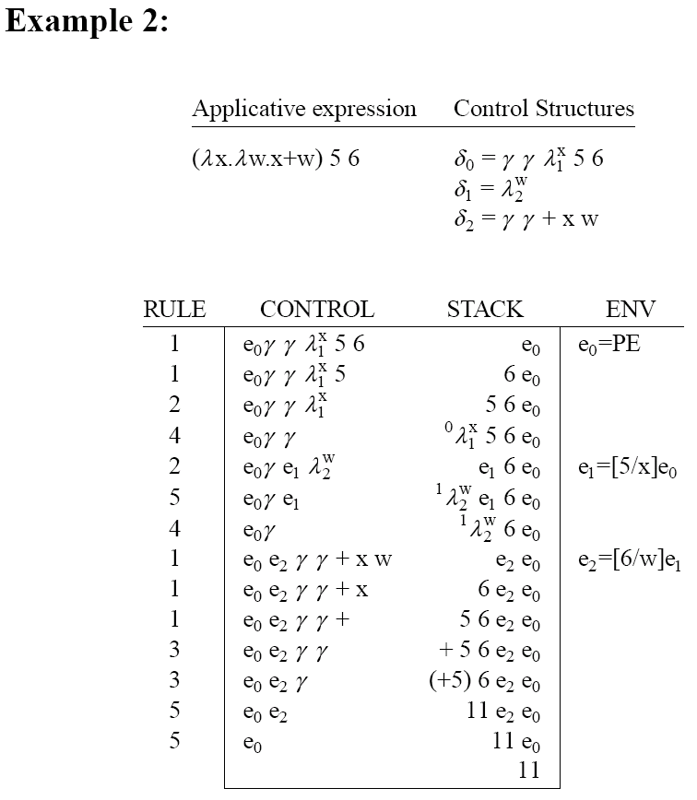

Slide 22
Five CSE Rules (Minimally) Sufficient
Let's take some shortcuts.
CSE Rules 6 and 7: Unary and Binary Operators.

Slide 23
Five CSE Rules (Minimally) Sufficient (cont’d)
In the control structures, abbreviate:
γ γ + to +
γ γ - to -
. . . (other binary operators)
γ neg to neg
γ not to not
In other words, DO NOT standardize unops and binops.

Slide 25
CSE Rule 8: Conditional
Do not standardize → node. Instead, for B → E1 | E 2, generate
δ_{then} δ_{else} β B, where
δ_{then} = control structure for E1
δ_{else} = control structure for E2
B evaluated first, then β pops the stack, keeps one δ and discards the other.

Slide 26
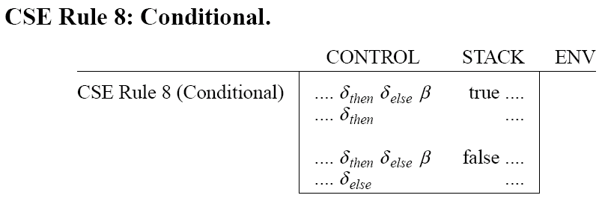

Slide 27
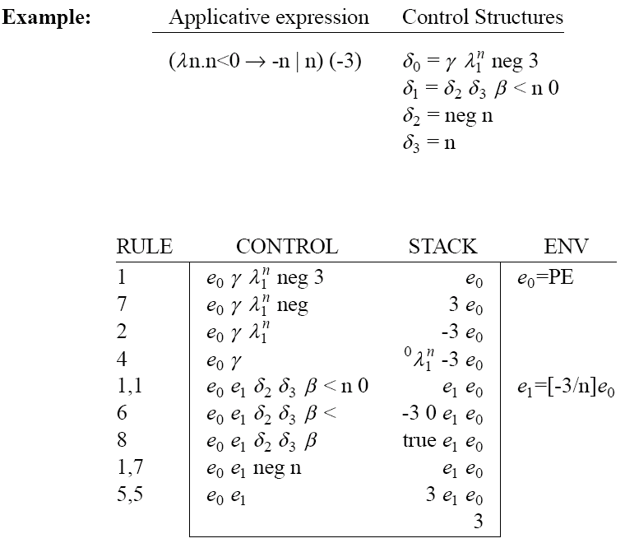

Slide 28
CSE Rules 9 and 10: Tuples
Do not standardize "tau“. Instead, for a tuple of the form (E1, E2, ..., En), generate the control structure tau_{n} E1 ... En.
tau_{n} will:
Pop the top n values from the stack,
Create a new n-tuple,
Push the tuple on the stack.
Note: tuple elements are evaluated right-to-left.

Slide 29
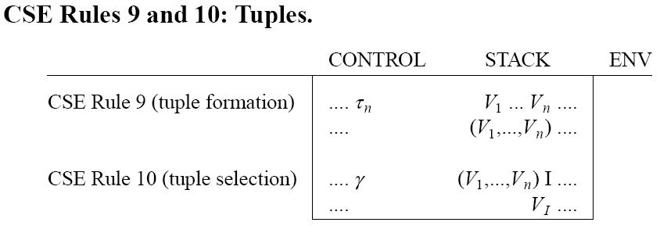

Slide 30
CSE Rule 11: n-ary Functions
Do not standardize the "," node.
Instead,
For λ(x,y).E, simply allow multiple bindings in one environment.

Slide 32
Thank You!

Slide 33
REFERENCES
Programming Language Pragmatics by Michael L. Scott. 3rd edition. Morgan Kaufmann Publishers. (April 2009).
Lecture Slides of Dr.Malaka Walpola and Dr.Bermudez

